Slide 1




Point of non-differentiability
Point of non-differentiability
$$1$$
$0$ $1$
$$0$$
HINGE LOSS
ReLU
$$\min_{w,b}{f\left(w,b\right)} \\ f\left(w,b\right)≝{\frac{1}{2}\left\|w\right\|}_{2}^{2}+C\sum_{i=1}^{n}{ℓ_{hinge}\left(y^{i}⋅\left(w^{⊤}x^{i}+b\right)\right)}$$
$$∇f\left(w,b\right)= ?$$

Slide 2
calculus of the non-differentiables
it is getting difficult to differentiate developments in the crypto-NFT world from joke articles on The Onion

Slide 3











Convex Functions Revisited
$$f:ℝ^{d}→ℝ$$
$$x$$
$$z$$
$$y$$
$$x$$
$$z$$
$$y$$
$$∀x,y$$
CONVEX FUNCTION
NON-CONVEX FN
$$∀λ∈\left[0,1\right]$$
If you “fill up” the space above the function curve and that set looks convex, then the function is convex too
$$z=λ ⋅x+\left(1−λ\right)⋅y$$
$$f\left(z\right)≤λ ⋅f\left(x\right)+\left(1−λ\right)⋅f\left(y\right)$$
A convex function must lie below all its chords

Slide 4


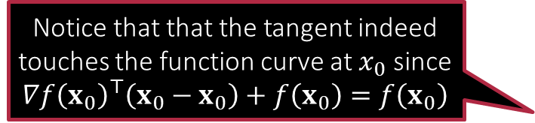




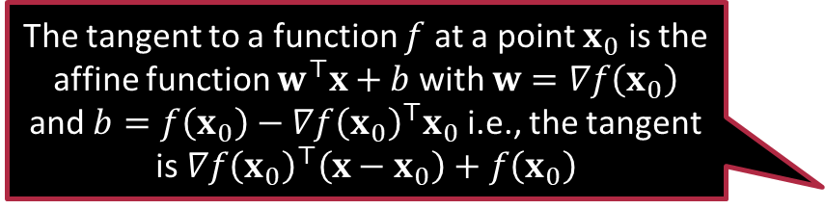

Convex Functions Revisited
Affine function is a fancy name for functions of the form $w^{⊤}x+b$
$$∇f\left(x\right)$$
$$∇f\left(x\right)$$
$$f:ℝ^{d}→ℝ$$
$$x$$
$$y$$
$$x$$
$$y$$
$$∀x,y$$
CONVEX FUNCTION
NON-CONVEX FN
$$f\left(y\right)≥f\left(x\right)+∇f{\left(x\right)}^{⊤}\left(y−x\right)$$
Notice that that the tangent indeed touches the function curve at $x_{0}$ since $$∇f{\left(x_{0}\right)}^{⊤}\left(x_{0}−x_{0}\right)+f\left(x_{0}\right)=f\left(x_{0}\right)$$
The tangent to a function $f$ at a point $x_{0}$ is the affine function $w^{⊤}x+b$ with $w=∇f\left(x_{0}\right)$ and $b=f\left(x_{0}\right)−∇f{\left(x_{0}\right)}^{⊤}x_{0}$ i.e., the tangent is $∇f{\left(x_{0}\right)}^{⊤}\left(x−x_{0}\right)+f\left(x_{0}\right)$
A differentiable convex function must lie above all its tangents

Slide 5


Derivatives of non-differentiable functions?
Let $f$ be a non-differentiable function that is at least convex
Hinge loss, ReLU are good examples
Recall: for differentiable functions, gradients give us tangents and a convex function must lie above all its tangent
Point of non-differentiability
Point of non-differentiability
$$1$$
$0$ $1$
$$0$$
HINGE LOSS
ReLU
Trick: turn this definition on its head
If an affine function $w^{⊤}x+b$ lies below the function and touches it at $x_{0}$, then the normal vector of that affine function i.e., $w$ can act as a gradient to the function at $x_{0}$

Slide 6



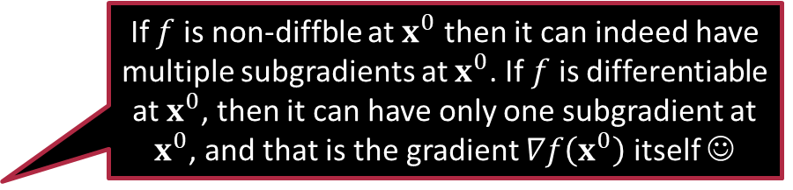

Subgradients and Subdifferentials
Tangents to convex functions satisfy two properties: they touch the function curve at one point and always lie below the function curve
Let $f:ℝ^{d}→ℝ$ be a (possibly non-differentiable but convex) function
At any $x_{0}∈ℝ^{d}$ suppose there exists a vector $g∈ℝ^{d}$ using which we define an affine function $h\left(x\right)≝g^{⊤}\left(x−x_{0}\right)+f\left(x_{0}\right)$
Note that $h\left(x_{0}\right)=f\left(x_{0}\right)$. However, if we also have $f\left(x\right)≥h\left(x\right)$ for all $x∈ℝ^{d}$, then $g$ is called a subgradient of the function $f$ at $x^{0}$
The set of all subgradients of $f$ at a point $x^{0}$ is the subdifferential of $f$ at $x^{0}$ and denoted by $∂f\left(x^{0}\right)$ $∂f\left(x^{0}\right)≝\left\{g :f\left(x\right)≥g^{⊤}\left(x−x^{0}\right)+f\left(x^{0}\right) ∀x\right\}$
If $f$ is non-diffble at $x^{0}$ then it can indeed have multiple subgradients at $x^{0}$. If $f$ is differentiable at $x^{0}$, then it can have only one subgradient at $x^{0}$, and that is the gradient $∇f\left(x^{0}\right)$ itself ☺
Wait! Does this mean a function can have more than one subgradient at a point $x^{0}$

Slide 7


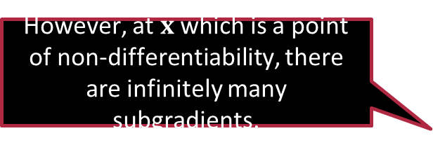



Subdifferential
At $y$ where the function is differentiable, there is just one subgradient – the gradient itself.
However, at $x$ which is a point of non-differentiability, there are infinitely many subgradients.
How can I find out the subgradients of a function?
There are rules of subdifferential calculus just as there are rules of regular calculus
$$x$$
$$y$$

Slide 8



Subdifferential Calculus Rules
$$x∈ℝ^{d},a∈ℝ^{d},b,c∈ℝ$$
Regular Calculus
Subdifferential Calculus
Scaling Rule
Sum Rule
Chain Rule
$∇\left(c⋅f\right)\left(x\right)=c⋅∇f\left(x\right)$
$∇\left(f+g\right)\left(x\right)=∇f\left(x\right)+∇g\left(x\right)$
$∇f\left(a^{⊤}x+b\right)=f^{′}\left(a^{⊤}x+b\right)⋅a$
$∂\left(c⋅f\right)\left(x\right)=c⋅∂f\left(x\right)$
$≝\left\{c⋅v :v∈∂f\left(x\right)\right\}$
$∂\left(f+g\right)\left(x\right)=∂f\left(x\right)+∂g\left(x\right)$
$≝\left\{u+v :u∈∂f\left(x\right),v∈∂g\left(x\right)\right\}$
$∂f\left(a^{⊤}x+b\right)=∂f\left(a^{⊤}x+b\right)⋅a$
$≝\left\{c⋅a :c∈∂f\left(a^{⊤}x+b\right)\right\}$

Slide 9



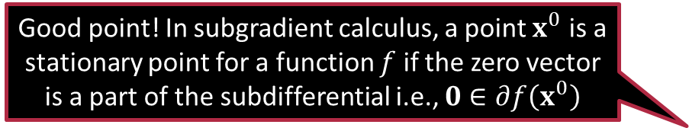
Subdifferential Calculus Rules – Max Rule
If $h\left(x\right)≝\max{ \left\{f\left(x\right),g\left(x\right)\right\}}$, then $∂h\left(x^{0}\right)=\left\{\begin{matrix}\begin{matrix}∂f\left(x^{0}\right) & if f\left(x^{0}\right)>g\left(x^{0}\right)\end{matrix} \\ \begin{matrix}∂g\left(x^{0}\right) & if g\left(x^{0}\right)>f\left(x^{0}\right)\end{matrix} \\ \begin{matrix}S\left(x^{0}\right) & if f\left(x^{0}\right)=g\left(x^{0}\right)\end{matrix}\end{matrix}\right.$ where $S\left(x^{0}\right)≝\left\{λu+\left(1−λ\right)v :u∈∂f\left(x^{0}\right),v∈∂g\left(x^{0}\right),λ∈\left[0,1\right]\right\}$
There is no counterpart to the max rule in regular calculus
This is because functions of the form $h\left(x\right)≝\max{ \left\{f\left(x\right),g\left(x\right)\right\}}$ usually turn out to be non-differentiable and so regular calculus falls silent anyway
Local minima/maxima must be stationary in this sense even for non-differentiable functions so we can use this fact to discover local minima/maxima for non-diff functions
What about stationary points?
Good point! In subgradient calculus, a point $x^{0}$ is a stationary point for a function $f$ if the zero vector is a part of the subdifferential i.e., $0∈∂f\left(x^{0}\right)$

Slide 10


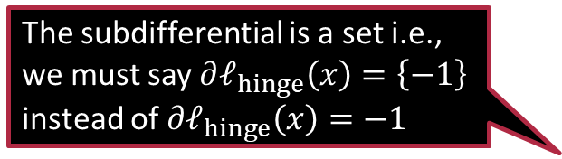

Differentiating the Hinge Loss
$ℓ_{hinge}\left(x\right)={\left[1−x\right]}_{+}=\max\left\{1−x,0\right\}$
Rewrite as $\max\left\{f\left(x\right),g\left(x\right)\right\},f\left(x\right)=1−x$, $g\left(x\right)=0$
Differentiable at all points except $x=1$
We get $∂ℓ_{hinge}\left(x\right)=\left\{−1\right\}$ if $x<1$
We also get $∂ℓ_{hinge}\left(x\right)=\left\{0\right\}$ if $x>1$
At $x=1$ use subdifferential calculus to get $∂ℓ_{hinge}\left(1\right)=\left\{λ⋅\left(−1\right)+\left(1−λ\right)⋅0 :λ∈\left[0,1\right]\right\}=\left[−1,0\right]$
Use the fact that $∂f\left(x\right)=\left\{f^{′}\left(x\right)\right\}=\left\{−1\right\}$ and $∂g\left(x\right)=\left\{g^{′}\left(x\right)\right\}=\left\{0\right\}$
$$1$$
$0$ $1$
The subdifferential is a set i.e., we must say $∂ℓ_{hinge}\left(x\right)=\left\{−1\right\}$ instead of $∂ℓ_{hinge}\left(x\right)=−1$

Slide 11

Differentiating the Hinge Loss
Can use chain rule to calculate more complicated subdifferentials
Given: a function $f:ℝ^{d}→ℝ$ defined as $f\left(w\right)≝ℓ_{hinge}\left(y^{i}⋅w^{⊤}x^{i}\right)$
Goal: find the subdifferential for the function i.e., $∂f\left(w\right)$
Applying the chain rule tells us that $∂f\left(w\right)=\left\{\begin{matrix}\begin{matrix} \left\{0\right\} & if y^{i}⋅w^{⊤}x^{i}>1\end{matrix} \\ \begin{matrix} \left\{−y^{i}⋅x^{i}\right\} & if y^{i}⋅w^{⊤}x^{i}<1\end{matrix} \\ \begin{matrix}\begin{aligned}\left\{c⋅y^{i}⋅x^{i},\right. \\ \left.c∈\left[−1,0\right]\right\}\end{aligned} & if y^{i}⋅w^{⊤}x^{i}=1\end{matrix}\end{matrix}\right.$

Slide 12

Exercise
Let $f\left(w\right)≝ℓ_{hinge}\left(y^{1}⋅w^{⊤}x^{1}\right)+ℓ_{hinge}\left(y^{2}⋅w^{⊤}x^{2}\right)$ where $w,x^{1},x^{2}∈ℝ^{d},y^{1},y^{2}∈ℝ$. For any $w∈ℝ^{d}$, find a subgradient of $f$ i.e., find a $v∈∂f\left(w\right)$
Note: no need to find the entire subdifferential, just any subgradient
Let $g\left(x\right)≝\left|x\right|+x^{2}$ where $x∈ℝ$. Find $∂g\left(x\right)$ at all $x∈ℝ$
Let $h\left(w\right)≝{\left(y^{1}−w^{⊤}x^{1}\right)}^{2}+{\left\|w\right\|}_{1}$. Find $∂h\left(w\right)$ at any $w∈ℝ^{d}$
Let $p\left(w\right)≝{\left(y^{1}−w^{⊤}x^{1}\right)}^{2}+{\left\|w\right\|}_{2}$. Find $∂p\left(w\right)$ at any $w∈ℝ^{d}$
Let $q\left(w\right)≝{\left(y^{1}−w^{⊤}x^{1}\right)}^{2}+{\left\|w\right\|}_{2}^{2}$. Find $∂q\left(w\right)$ at any $w∈ℝ^{d}$
Note: for last 4 questions, need to find the entire subdifferential

Slide 13
Summary
Non-differentiable functions are common in ML applications
Concepts of gradient can be extended to non-differentiable cvx fns
Involve studying the relationship between gradients and tangents
Allow us to develop the notion of subdifferential
Instead of a unique gradient, may have several (infinite) subgradients
Elegant extension: for differentiable functions, unique subgradient
Rules of subdifferential calculus that ease calculations
Scaling rule, sum rule, chain rule, max rule

Slide 14
Stay amazing!
See you next time.

